Slide 1

Machine learning On AWS: SageMaker
Team 9: Zeyang Zhou

Slide 2

content
Overview
SageMaker Notebook instance
SageMaker Autopilot
Conclusion

Slide 3

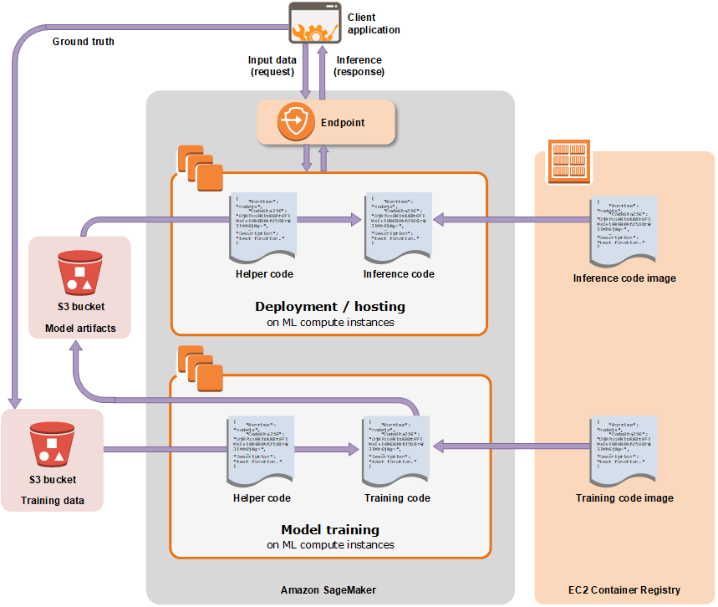
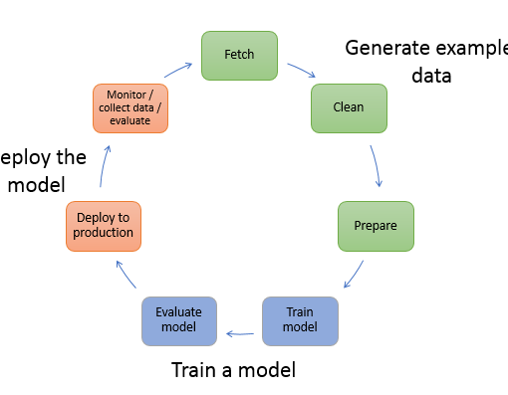
oVERVIEW
1. What is SageMaker?
Amazon SageMaker is a managed machine learning service (MLaaS). It lets you quickly build and train machine learning models and deploy them directly into a hosted environment.
2. Machine Learning
Machine learning (ML) is the study of computer algorithms that improve automatically through experience and by the use of data or information. In machine learning, algorithms are trained to find patterns and correlations in large datasets and to make the best decisions and predictions based on that analysis.
Notes:
Evaluating the model—After you've trained your model, you evaluate it to determine whether the accuracy of the inferences is acceptable. In SageMaker, you use either the AWS SDK for Python (Boto) or the high-level Python library that SageMaker provides to send requests to the model for inferences.

Slide 4
Objective
Basic knowledge of Amazon SageMaker
SageMaker Notebook & SageMaker Autopilot
How to do machine learning tasks with SageMaker
Notes:
configure the environment

Slide 5
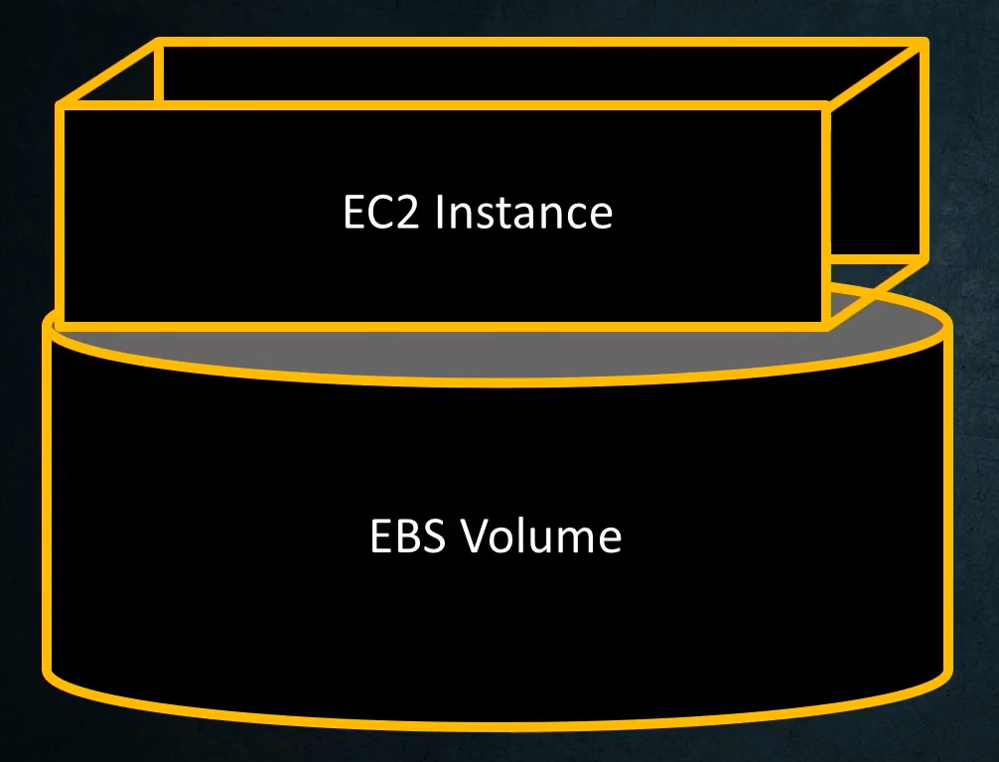
NOTEBOOK INSTANCE
EC2 instance + EBS volume (5GB)
1. Pick the right family
{t, m, c, p}
2. Pick the right size
Medium, large, xlarge…
3. Pick the right version
ml.m5.large: family + version + size
Notes:
AWS Elastic Block Store EBS: store data volume: default 5GB; An Amazon SageMaker notebook instance is a ML compute instance running the Jupyter Notebook App. SageMaker manages creating the instance and related resources. Use Jupyter notebooks in your notebook instance to prepare and process data, write code to train models, deploy models to SageMaker hosting, and test or validate your models.
The console uses your sign-in credentials to send a CreatePresignedNotebookInstanceUrl API request to SageMaker. SageMaker returns the URL for your notebook instance, and the console opens the URL in another browser tab and displays the Jupyter notebook dashboard.
For IAM role, choose Create a new role, and then choose Create role. This IAM role automatically gets permissions to access any S3 bucket that has sagemaker in the name. It gets these permissions through the AmazonSageMakerFullAccess policy, which SageMaker attaches to the role.

Slide 6
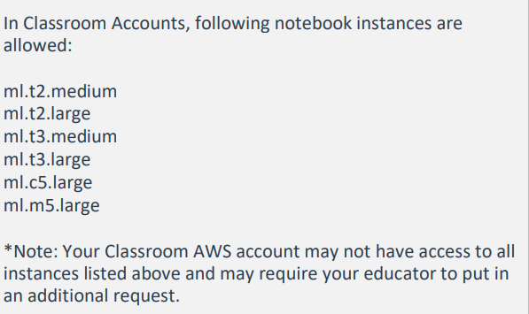
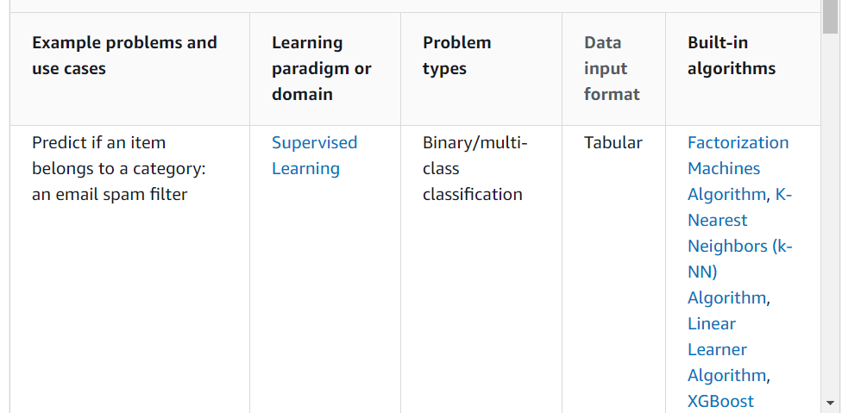
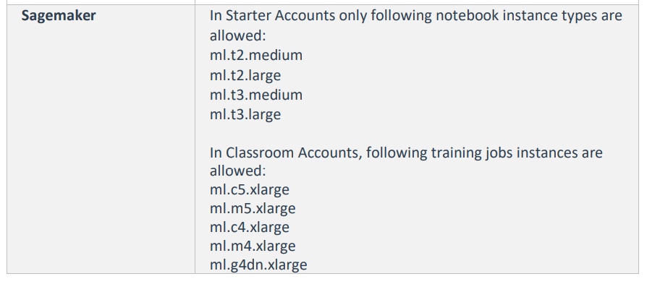
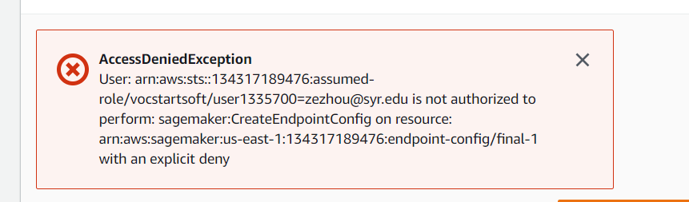
Suggested instance type
For training and hosting Amazon SageMaker algorithms, we recommend using the following Amazon EC2 instance types:
ml.m5.large, ml.m5.xlarge, ml.m5.4xlarge, and ml.m5.10xlarge
ml.c5.xlarge, ml.c5.2xlarge, and ml.c5.8xlarge
ml.p3.xlarge, ml.p3.8xlarge, and ml.p3.16xlarge
Notes:
Starter account
Amazon SageMaker provides a suite of built-in algorithms to help data scientists and machine learning practitioners get started on training and deploying machine learning models quickly. For someone that is new to SageMaker, choosing the right algorithm for your particular use case can be a challenging task. The following table provides a quick cheat sheet that shows how you can start with an example problem or use case and find an appropriate built-in algorithm offered by SageMaker that is valid for that problem type. Additional guidance organized by learning paradigms (supervised and unsupervised) and important data domains (text and images) is provided in the sections following the table.
Users get started on training and deploying machine learning models quickly. For someone that is new to SageMaker, choosing the right algorithm for your particular use case can be a challenging task.
Supervised Learning
Unsupervised Learning
Unsupervised Learning
Image Processing

Slide 7
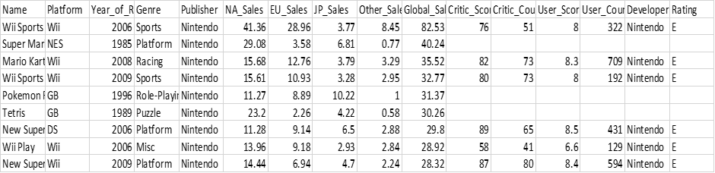
Data set
The dataset used in this demo is found at Kaggle (Kaggle, 2016) which contains a list of video games with sales greater than 100,000 copies from 1980 to 2016
Notes:
eXtreme Gradient Boosting (XGBoost) is a popular and efficient machine learning algorithm used for regression and classification tasks on tabular datasets. It implements a technique known as gradient boosting on trees, which performs remarkably well in machine learning competitions.
Amazon Simple Storage Service (Amazon S3) is an object storage service that offers industry-leading scalability,

Slide 8
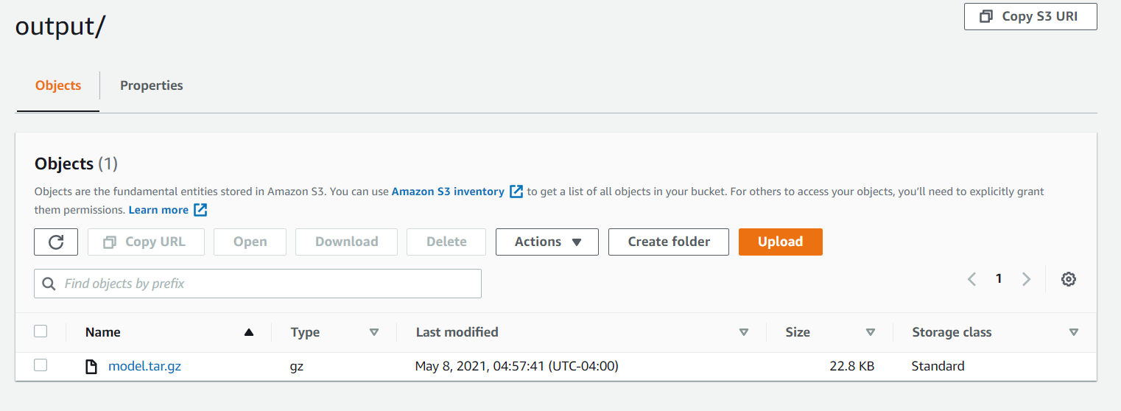
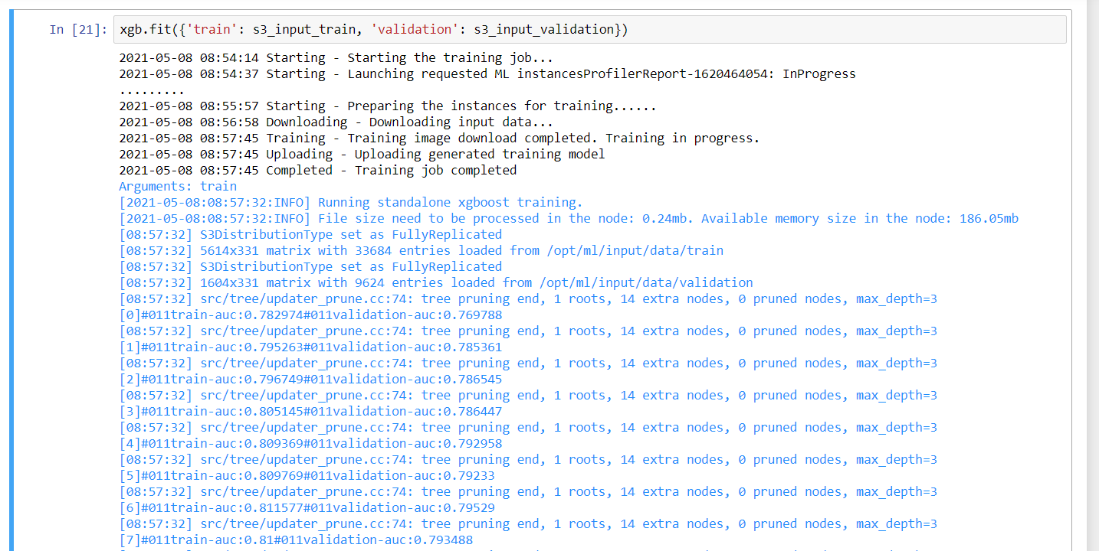
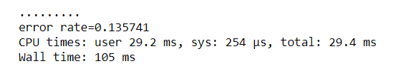
Result
Notes:
In a few minutes, Amazon SageMaker launches an ML compute instance—in this case, a notebook instance—and attaches an ML storage volume to it. The notebook instance has a preconfig
ured Jupyter notebook server and a set of Anaconda libraries.
Use containers to quickly scale machine learning models for training and inference and run them close to your data sources on any platform.

Slide 9
Demo-1
https://video.syr.edu/media/t/1_scw6yz6t

Slide 10
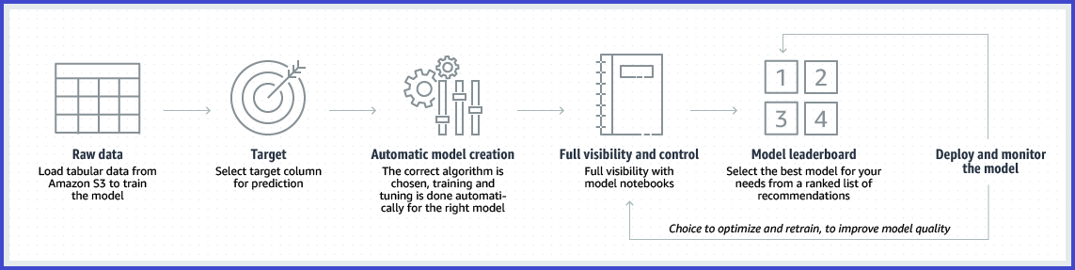
SAGEMAKER aUTOPILOT
Amazon SageMaker Autopilot is a feature-set that automates key tasks of an automatic machine learning (AutoML) process. It explores your data, selects the algorithms relevant to your problem type, and prepares the data to facilitate model training and tuning. It simplifies your machine learning experience by automating these key tasks that constitute an AutoML process. It ranks all of the optimized models tested by their performance. It finds the best performing model that you can deploy at a fraction of the time normally required.

Slide 11
Algoritms
Autopilot algorithm support
Autopilot supports three types of machine learning algorithms to address machine learning problems:
Linear Learner Algorithm: a supervised learning algorithms used for solving either classification or regression problems.
XGBoost Algorithm: a supervised learning algorithm that attempts to accurately predict a target variable by combining an ensemble of estimates from a set of simpler and weaker models.
Deep Learning Algorithm: multilayer perceptron (MLP), a feedforward artificial neural network that can handle data that is not linear separable.

Slide 12
Problems
Regression
Regression estimates the values of a dependent target variable based on one or more other variables or attributes that are correlated with it. An example is the prediction of house prices using features like the number of bathrooms and bedrooms, square footage of the house and garden. Regression analysis can create a model that takes one or more of these features as an input and predicts the price of a house.
Binary classification
Binary classification is a type of supervised learning that assigns an individual to one of two predefined and mutually exclusive classes based on their attributes. It is supervised because the models are trained using examples where the attributes are provided with correctly labelled objects. A medical diagnosis for whether an individual has a disease or not based on the results of diagnostic tests is an example of binary classification.
Multiclass classification
Multiclass classification is a type of supervised learning that assigns an individual to one of several classes based on their attributes. It is supervised because the models are trained using examples where the attributes are provided with correctly labelled objects. An example is the prediction of the topic most relevant to a text document. A document may be classified as being about, say, religion or politics or finance, or about one of several other predefined topic classes.

Slide 13
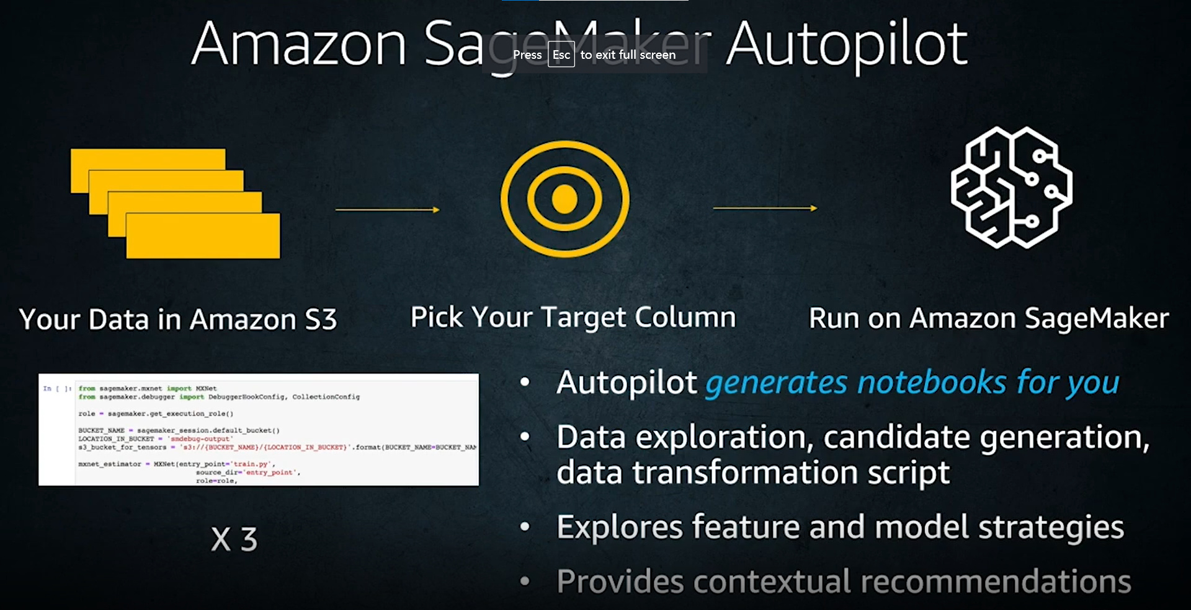
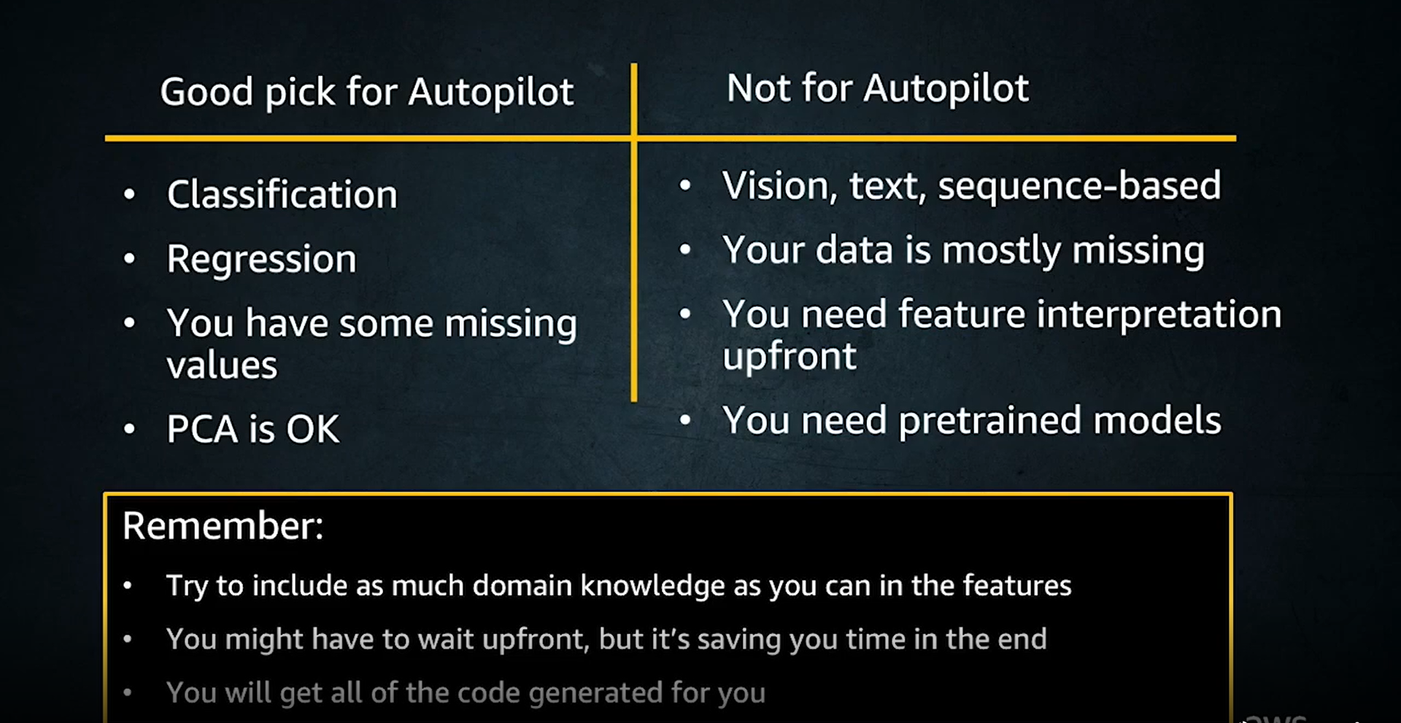
PROS AND CONS
Pros:
Automatically
Background
Cons:
Pricing
limitation

Slide 14
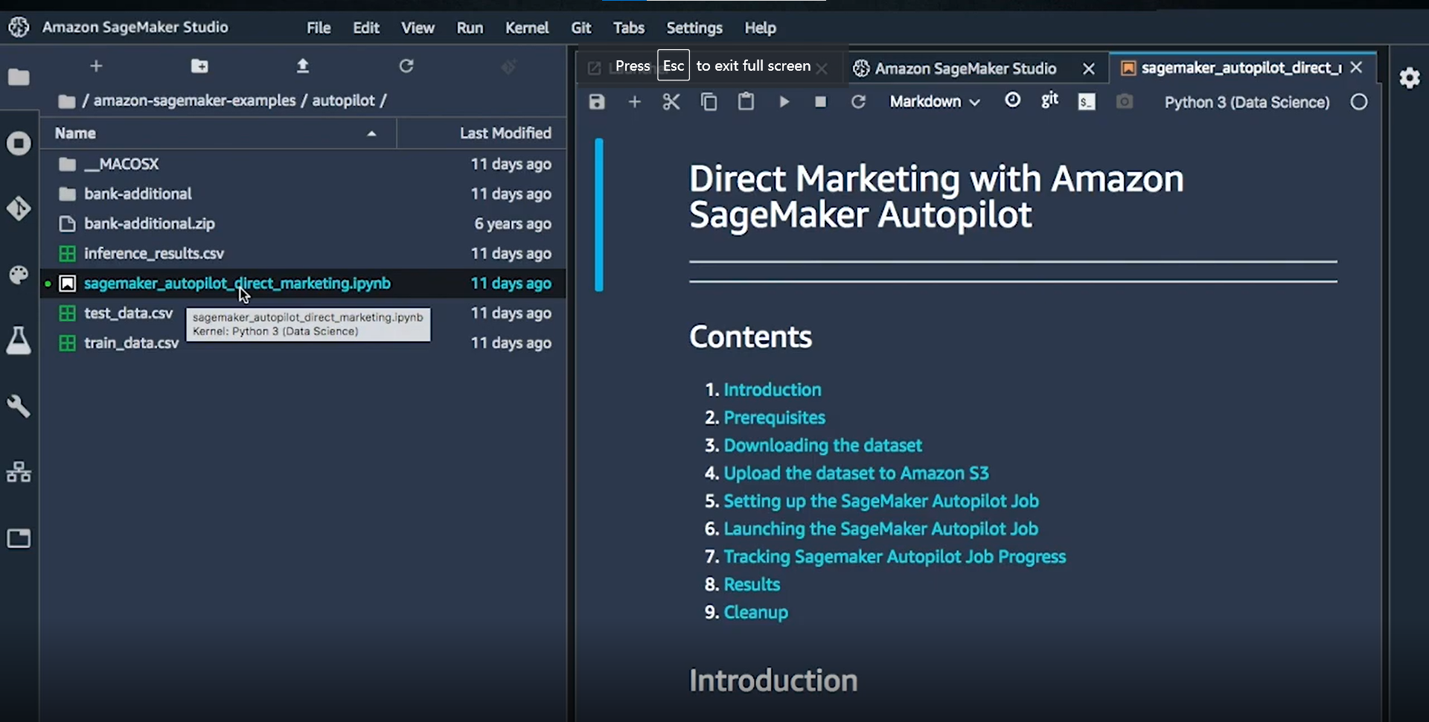
Experiment

Slide 15
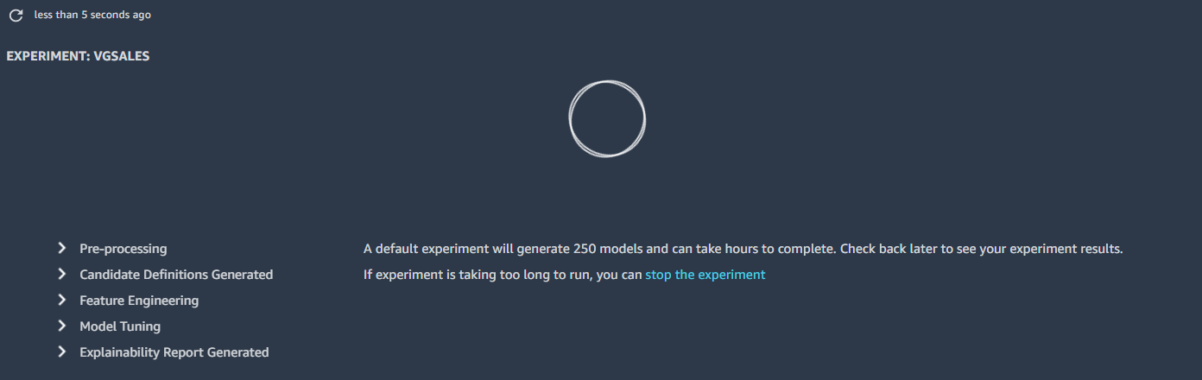
5 steps

Slide 16
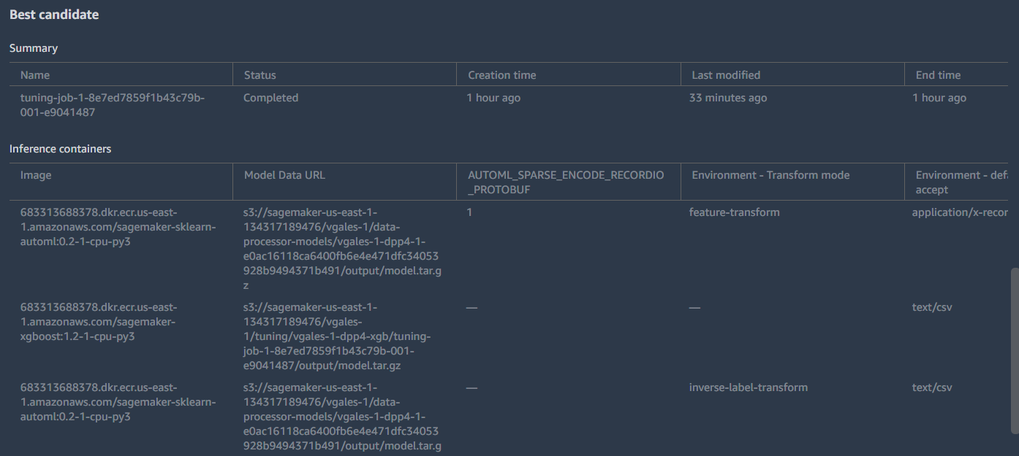
Results

Slide 17
Demo-2
https://video.syr.edu/media/t/1_bsqq8ll7

Slide 18
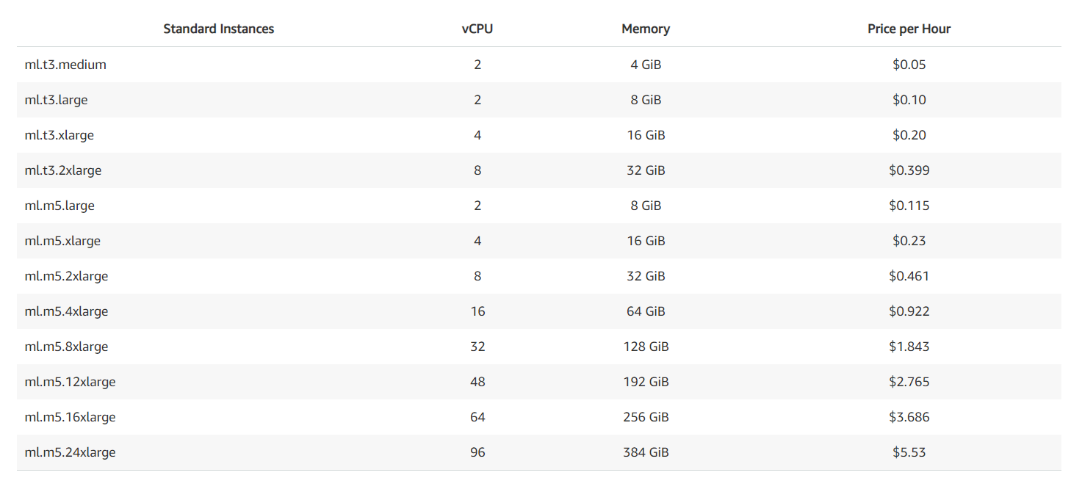
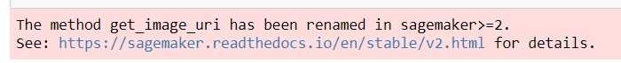
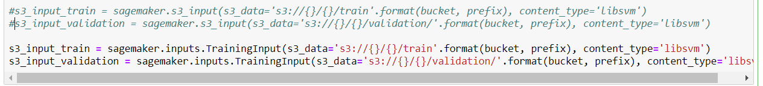
Conclusion
Issues:
1. Restriction
2. Pricing
3. Instruction and examples
4. Community
5. Complicated and hardcore
Notes:
Instruction video and example to old version: sagemaker version 1; The latest version is version 2.x. a lot of function are renamed or deprecated or be integrated into another class, Syntax difference.

Slide 19

Final Project
Thanks
May 10, 2021
Syracuse University
iSchool - IST 615
Zeyang Zhou
Reporter:

